Slide 1

Data Magicians – Machine Learning Concept Map
Kennesaw State University
Spring 2025
CS7267 – Machine Learning

Slide 2
Team Introduction & Task Assignments
Daylin Hart: Concept Extraction
Juston Bryant: Relationship Modeling
Ashley Archibald: Evaluation & Testing

Slide 3
Related Research Work
Mention related work in NLP:
Named Entity Recognition
Relation Extraction
Knowledge Graph construction

Slide 4
Intuition Behind the Method
Human understand content better through connections.
Concept maps visually reinforce key ideas + relationships.
Breaking text into smaller chunks enhances sematic clarity.

Slide 5

Methodology Overview
Load and split text(chapters)
Extract top concepts from each chunk.
Extract relationships between concepts.

Slide 6
Data Handling
Data source: Chapters from textbook
Train/Test split:
Train: Ch 1-5, 7-9, 13-19
Test: Ch 6, 10-12

Slide 7
Concept Extraction Logic
Use ConceptExtractor:
Rank top N concepts in each chunk
Tokenization + Filtering
Benefits of chunking text(1000- word window)

Slide 8
Relationship Extraction Logic
RelationshipExtractor
Extracts co-occurances or sematic links
Limits total extracted relationships to avoid clutter
Outputs: list of pairs + optional weights

Slide 9

Graph Contruction + Visualization
Graph built using extracted nodes and edges
Static PNG and interactive HTML generated
Tools: NetworkX, Matplotlib, HTML export

Slide 10
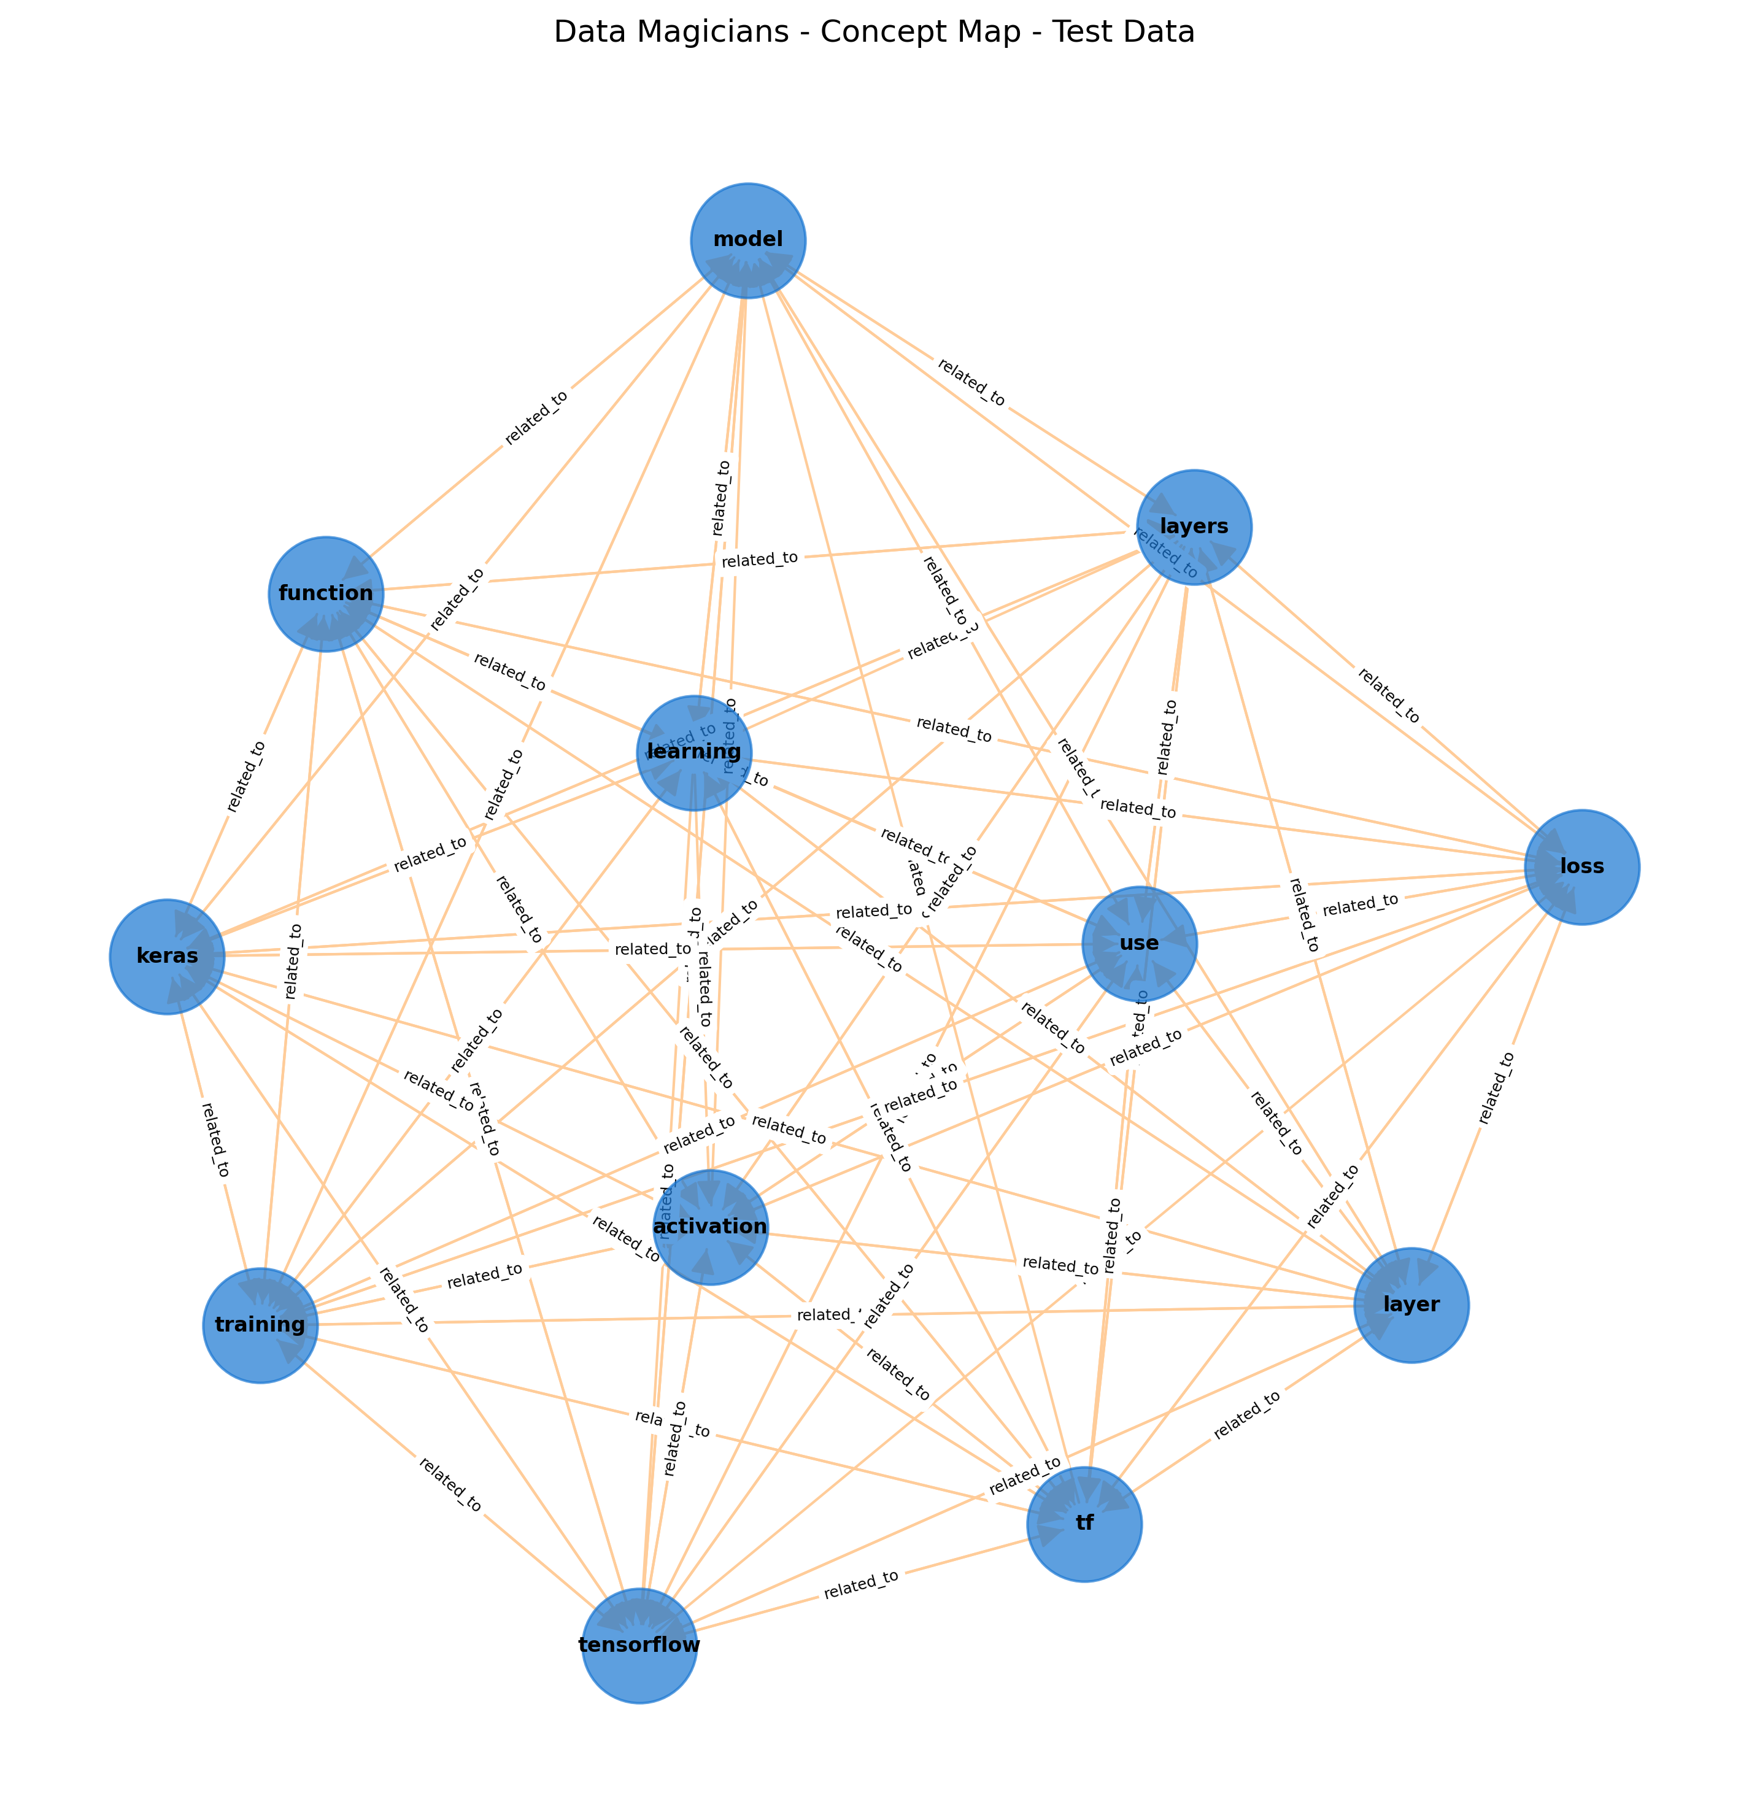
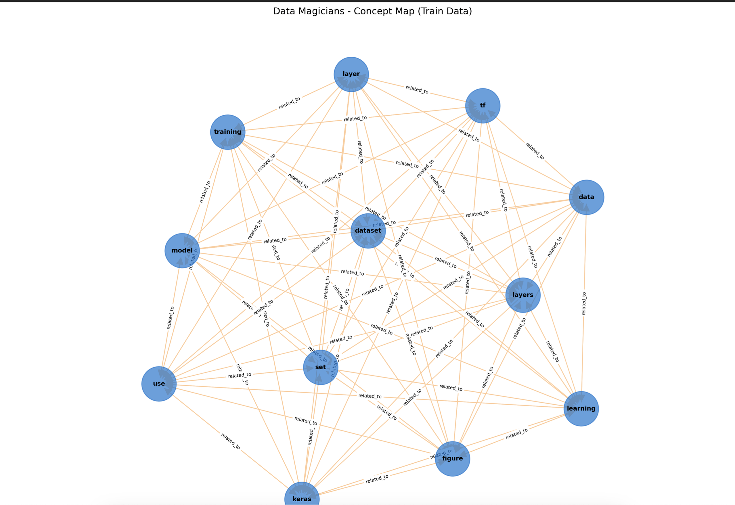
Concept Map – Train & Test Data

Slide 11
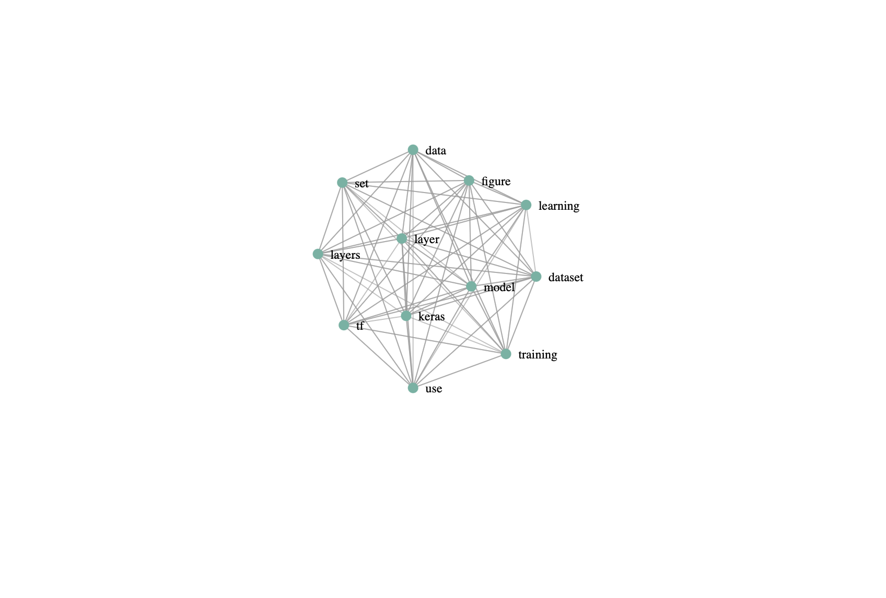
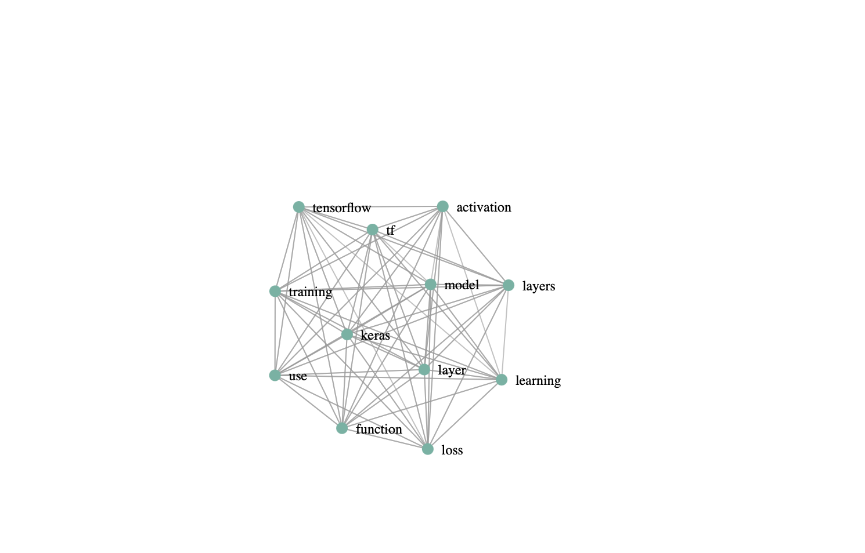
Concept Map (HTML graph interaction)

Slide 12
Discussion / Results
Learned how to:
Normalize filenames + handle file errors
Break down NLP into smaller pipelines
Use visualization to uncover sematic structures.
Train concepts extracted
Test concepts extracted
Relationship edges formed

